Slide 1
Evaluation of Models – Overview of Models Run
Based on the models run, the Gradient Boosted Classifier seems to be one of our best predictors

Slide 2
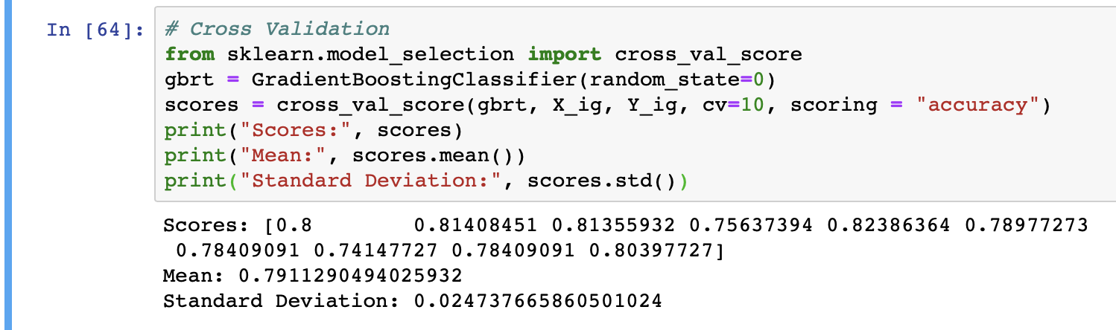
Evaluation of Models
Checking Validity of our Accuracy Score
k-Fold Cross-Validation is a resampling procedure used to evaluate machine learning models on a limited data sample.

Slide 3
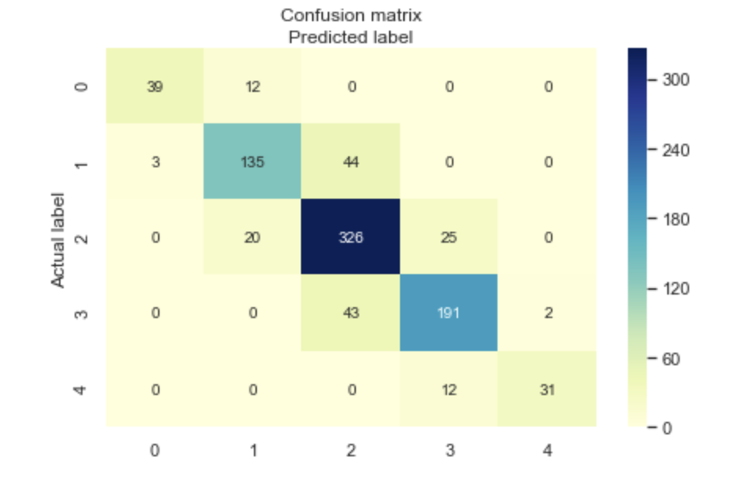
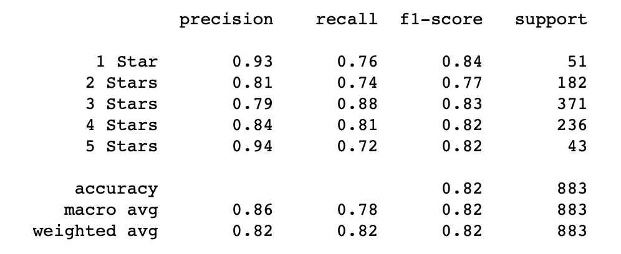
Evaluation of Models
Check for Accuracy Paradox
The accuracy paradox is the paradoxical finding that accuracy is not a good metric for predictive models when classifying in predictive analytics.

Slide 4
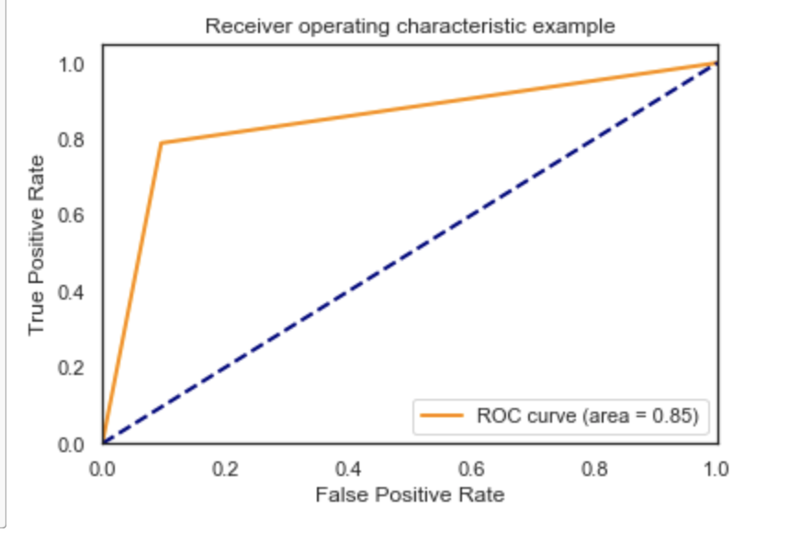
Evaluation of Models Check our Model Classification Ability - ROC AUC Curve
The AUC (Area Under The Curve) ROC (Receiver Operating Characteristics) curve, also called AUROC (Area Under the Receiver Operating Characteristics), tells how much model is capable of distinguishing between classes. Higher the AUC, better the model is at predicting.

